Slide 1
Year 2 Mentoring
Dr. Tyler Kulp
Associate Superintendent of the Catholic Schools in the Diocese of Wilmington
10/7 - 3:30 pm

Slide 2
Prayer…
In the name of the Father, the Son, and the Holy Spirit, Amen.
Heavenly Father,
Pope Francis reminds us that “Education is an act of love that illuminates the path for us to recover a sense of fraternity, so we will not ignore those who are most vulnerable.”
As we begin this mentoring journey year, bless us with the grace to be instruments of Your love and builders of fraternity in our classrooms. Help us to recognize and support the most vulnerable among us, in whatever form that vulnerability takes.
Grant us patience, joy, and strength as we grow in this vocation of teaching, and may everything we do reflect Your presence.
We ask this through Christ our Lord. Amen.
In the name of the Father, the Son, and the Holy Spirit, Amen.

Slide 3
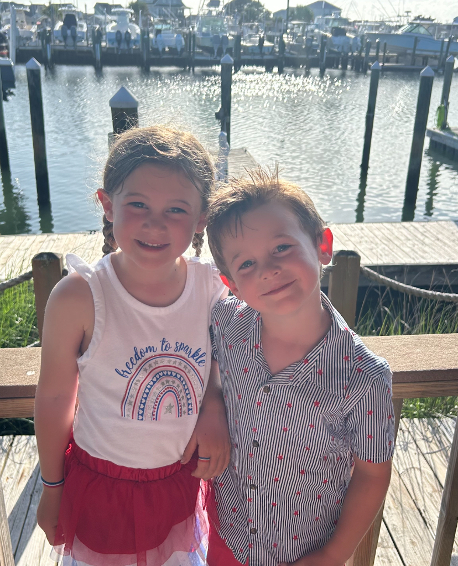
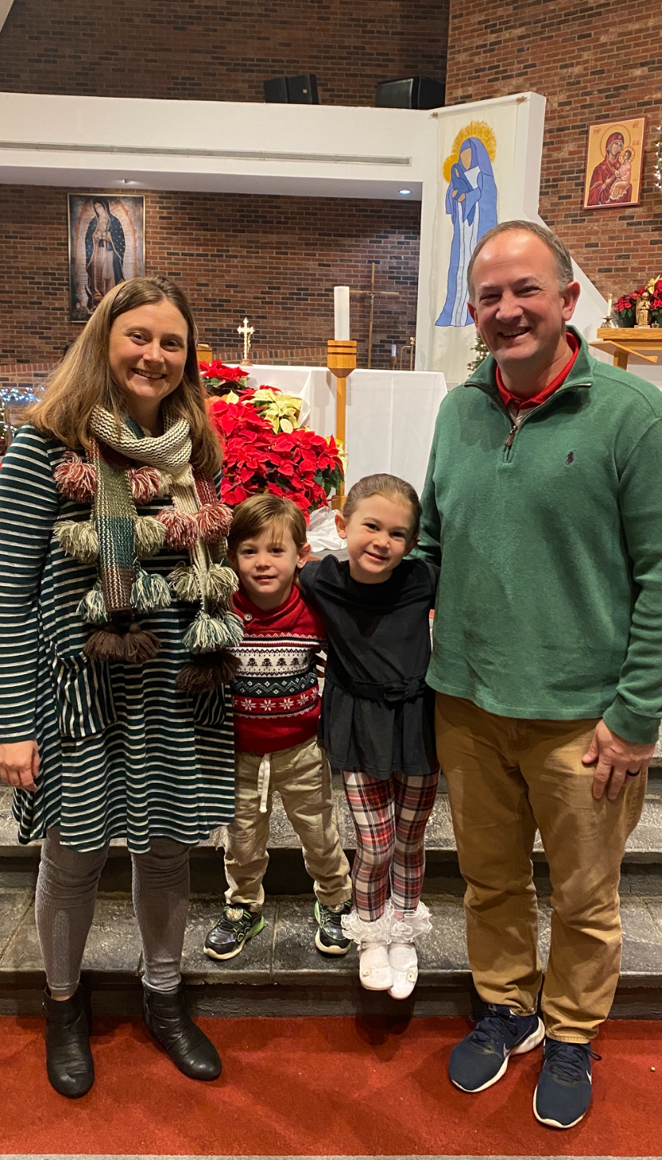

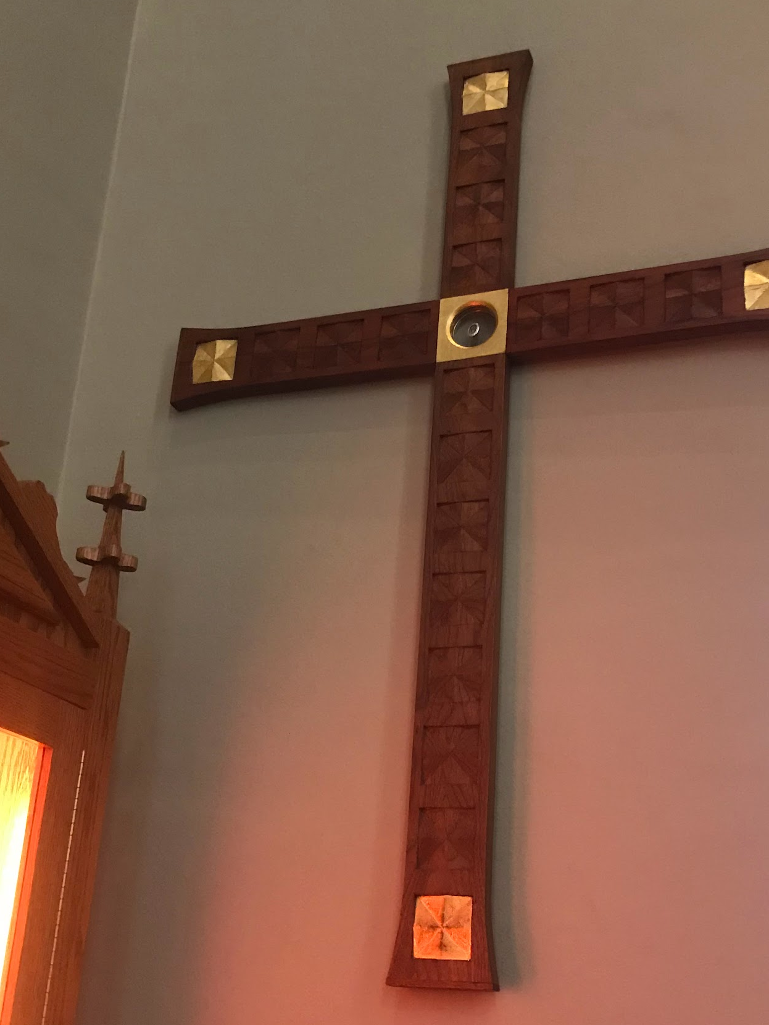

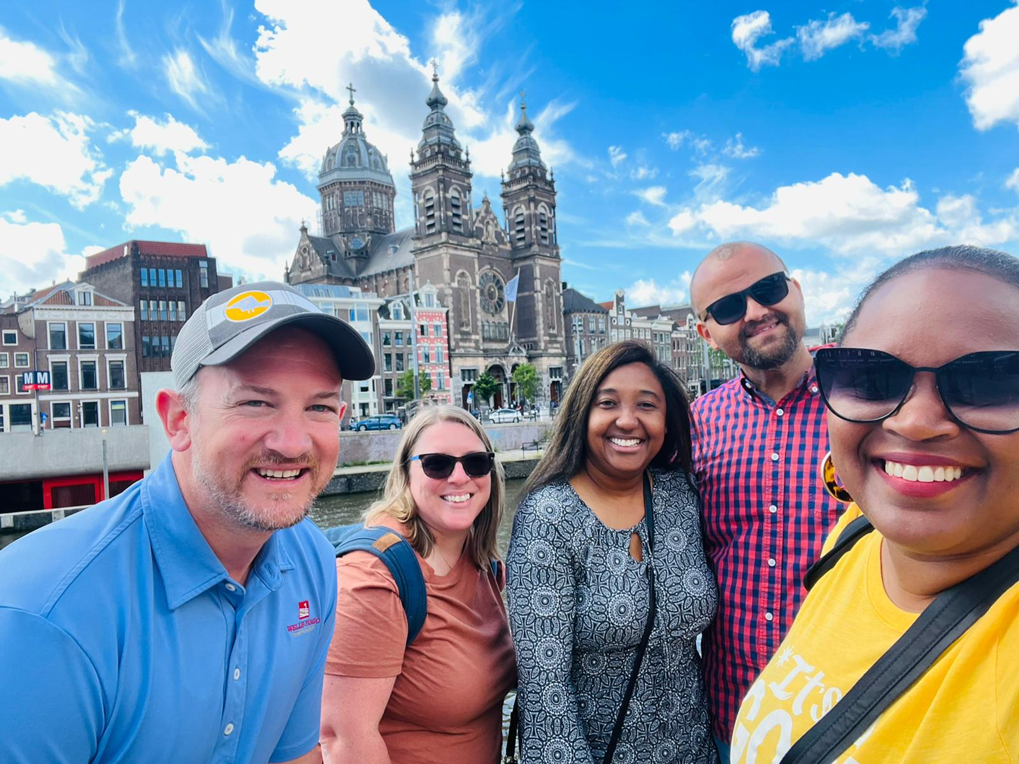
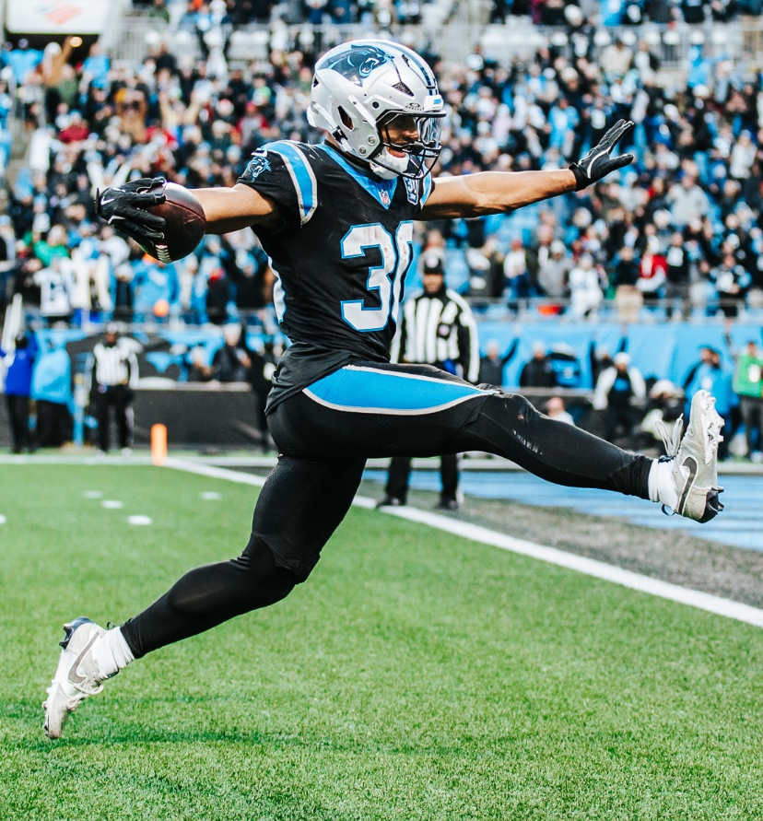
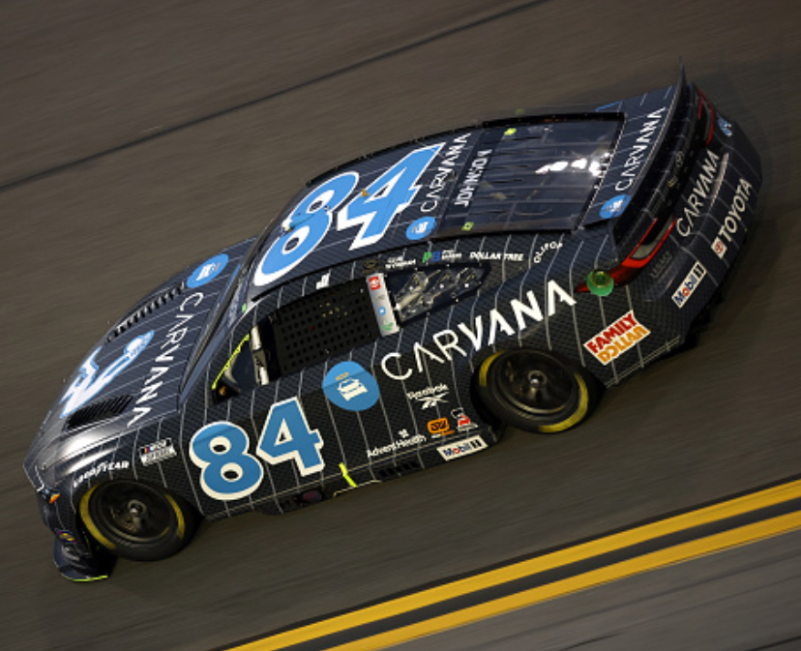
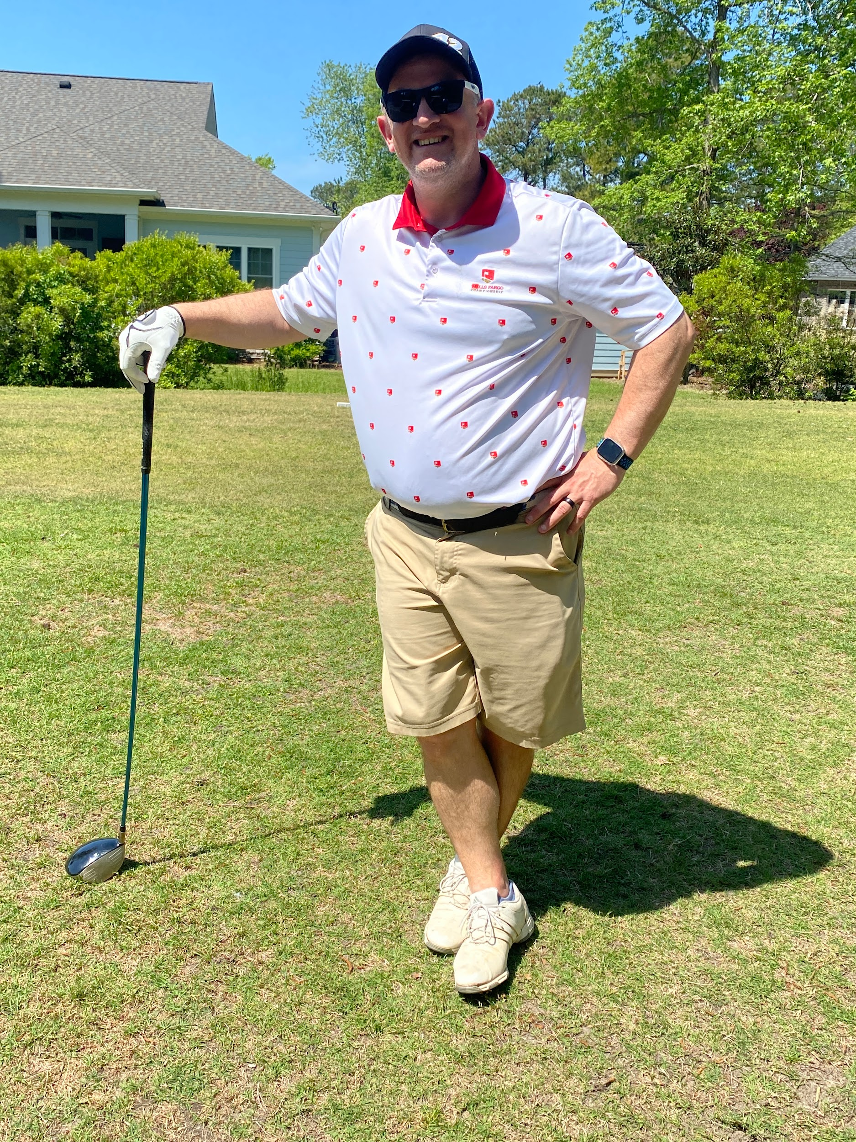
About Dr. Kulp….

Slide 4
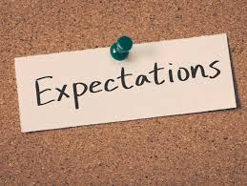
Purpose of today….
Expectations Overview!

Slide 5
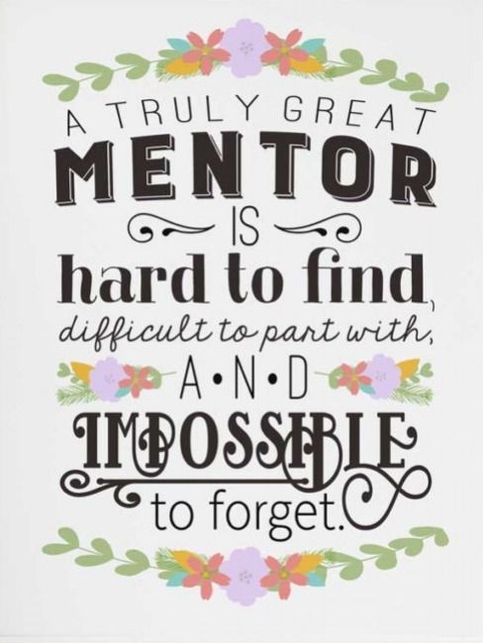
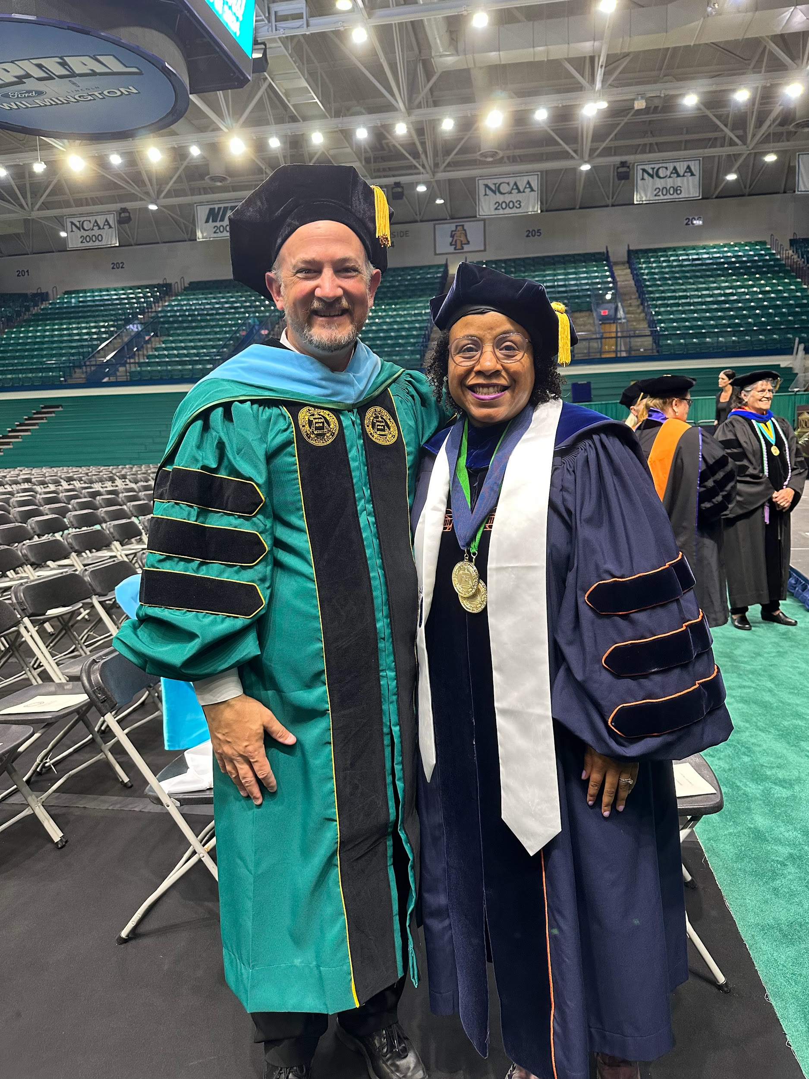

Slide 6
Year Two Overview
The Mentor must:
Review, critique, and approve the mentee’s SMART goal for the year.
Review the observation notes of three observations of a veteran teacher
Review discussion logs.
Periodically review and ultimately verify the work done on the current year plan.
Periodically review the Mentee’s Log/Tally of Hours.
Review and critique the Mentee’s reflections.
Ultimately, review and approve the Mentee’s portfolio and sign off on end-of-year paperwork.
The Mentee must: a) Develop and submit a clear, measurable SMART goal for the year for Mentor review and approval. b) Actively participate in classroom observations and provide observation notes/discussion logs to the Mentor. c) Consistently work on the current year SMART goal and share progress updates with the Mentor. d) Maintain an accurate and up-to-date Log/Tally of Hours for periodic review. e) Complete thoughtful written reflections and submit them to the Mentor for feedback. f) Compile and organize a professional portfolio and complete all end-of-year paperwork for Mentor review and approval.
g) Have a willingness to participate with an open mindset to learning and ongoing growth
h) Be open to constructive criticism
FORMS….

Slide 7
Purpose of Mentoring Year 2 - Meetings and Program
Meeting Focuses:
Learning Targets
Varied Instructional Strategies
Diversified Assessment Methods
Mastery of certain aspects of education…..
Mentorship
Growth Reflection

Slide 8
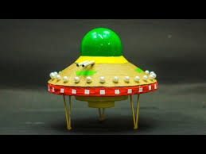
Kulp 7th Grade Example….
Kulp’s UFO Project
7th Grade Geometry was a struggle!
How can I meet the learning target of the 7th grade Geometry Standards?
How can I establish:
Collaboration
Learning Targets with Standards
Creativity
Writing
“Hands On”
Fun yet difficult!
One of those projects at CLMS..
Why? I wanted to master ONE thing, and I learned so much more from it!!!!

Slide 9

Hedgehog Concept
The Hedgehog Concept
Greatness comes from understanding what you can be best in the world at, what drives your economic engine, and what you are deeply passionate about.
The Hedgehog Concept for Second-Year Teachers
1. Purpose – Why do you teach? What are you deeply passionate about? → How do clear and meaningful learning targets reflect your passion for teaching and guide students toward purposeful learning?
2. Practice – What part of teaching can you master? What can you be best in the world at? → Which instructional strategies can you intentionally develop and refine to engage all learners and bring your classroom vision to life?
3. Performance – How do you know you’re making a difference for students? What drives your resource engine? → How do diversified assessments—formative, summative, and authentic—help you measure growth, adjust instruction, and celebrate student success?
Good to Great
Jim Collins

Slide 10

Binder Organization
Recommended Binder Set-Up
Tab 1 - Program Requirements & Calendar
Year 2 overview, expectations, and deadlines (checklist format).
Schedule of after-school meetings, PD Day, and portfolio due dates.
SMART Goal
Tab 2 - Professional Learning Sessions
Notes, handouts, and resources on: Learning Targets, Instructional Strategies, and Assessment Methods
Tab 3 - Mentor Collaboration
Space for log of hours
Observation notes and discussion logs
Follow-up reflection prompts.
Artifacts to support collaboration
Tab 4 - Professional Development & Observations
Certificates (ethics course, diocesan PD day).
Veteran teacher observation notes and reflection pages.
Tab 5 - Portfolio & Growth Reflections
Portfolio submission guidelines
Year 2 reflection prompt and Year 3 goal-setting pages.
Recommended

Slide 11
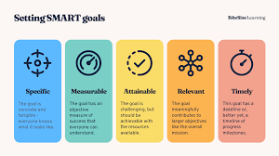
Actions Steps for Mentors and Mentees
Go through the Y2 Overview Document together
Go through forms together
Organize Binder
SMART GOAL Prep….
Recommended

Slide 12
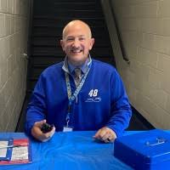
I am here to support!
Answer questions via:
Email
Phone Call
Visiting schools
One on One or with Mentor/Mentee
Forms, CSO Intranet
I am looking forward to a great year!

